Slide 1
Software Quality Recipes for Legacy .NET Applications
Matt Eland
@IntegerMan
https://www.Linkedin.com/in/MattEland/
Slides and code available at: https://GitHub.com/IntegerMan/SoftwareQualityTalk/

Slide 2
About Me
.NET / TypeScript / Angular Developer turned Manager / Mentor
Programming
For fun since 1987
.NET since 2001 (Beta 2)
Professionally since 2006
Addicted to Reading and Refactoring

Slide 3
My Background
Currently:
Software Engineering Manager at MoveHQ (1 year)
Previously:
Senior Software Engineer at TeamDynamix (9 years)
Software Developer at Exceptional Innovation (3 years)
Software Engineer at Verizon Business (6 months)

Slide 4
About This Talk
Intended to introduce variety of tools and ideas to give you options when working with legacy code
Primer on Unit Testing in C#
.NET Libraries useful for improving tests
Other Testing Techniques
Quality Analysis Primer

Slide 5

This Talk Is NOT
Focused on any particular .NET project type
ASP .NET, XAML, Web API etc
Focused extensively on any one library or tool
Code-Intensive
Solely about unit testing
403 FORBIDDEN

Slide 6
Example Codebase: Resume Scoring Algorithm
Resume Information
System
Under Test
Resume Score

Slide 7
Example Codebase Overview
Written by “Interns”
(or me playing devil’s advocate)
Effectively a single long method
High degree of coupling
Uses EntityFramework to check keywords by value
Needs urgent refactoring

Slide 8
Current Testing Problems
Depends on a Database Connection
Undocumented Business Requirements
Too many Unique Paths through the Code (Cyclomatic Complexity)

Slide 9
A Primer on Software Testing

Slide 10
Types of Tests
Integration Tests
Manual
Unit / Component Tests
UI Automation
Exploratory

Slide 11
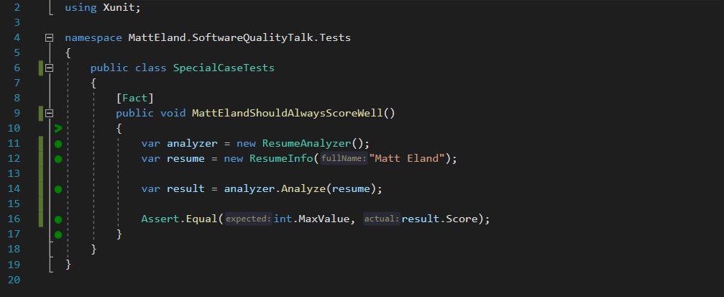
What is a Unit Test?

Slide 12
What is a Unit Test? – Detected by Attribute

Slide 13
What is a Unit Test? – Exercises System Under Test

Slide 14
What is a Unit Test? – Contains Assertions

Slide 15
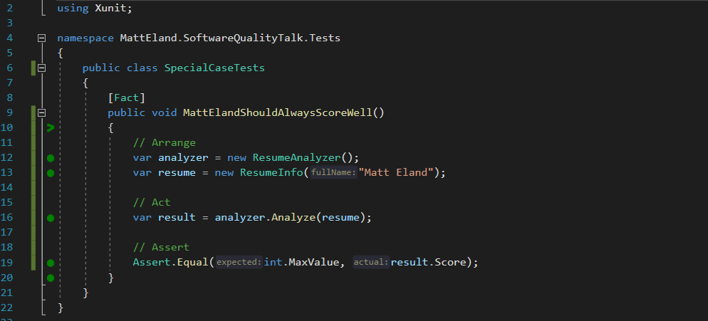
What is a Unit Test? – Arrange / Act / Assert

Slide 16
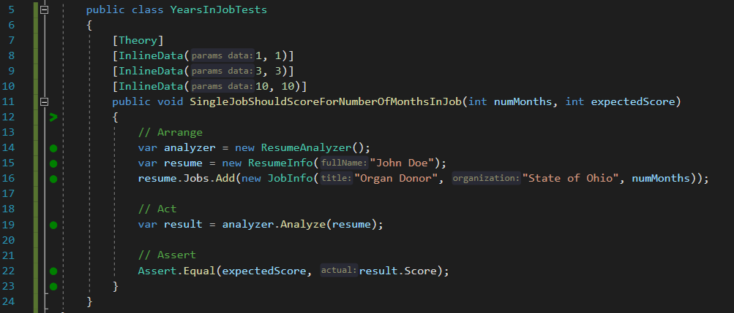
Parameterized Unit Tests

Slide 17



Unit Testing Frameworks
MSTest
NUnit
XUnit
Already installed in Visual Studio
[TestMethod] / [DataTestMethod]
MSTest2 closes gaps the original had
Port of frameworks like Junit
[Test] / [TestCase]
Often more integration support
More recent addition
[Fact] / [Theory]
More favored in .NET Core applications
See https://raygun.com/blog/unit-testing-frameworks-c/ for detailed analysis of different frameworks

Slide 18
Test Driven Development (TDD)
Green
Clean up System Under Test
Red
Write a failing test
Make the test pass
Refactor

Slide 19

But I can’t test my code because _______________ !

Slide 20
But I can’t test my code because _______________ !
Database Dependencies
Some options:
Remove the database dependency via Dependency Injection
Use Entity Framework and in-memory database tests
Keep talking to the database, but work around the limitation

Slide 21
But I can’t test my code because _______________ !
it works with the UI
Some options:
Then don’t write tests for it.
Make the view layer as small and dumb as possible, then test the rest
Selenium tests for web / Coded UI tests for desktop

Slide 22
But I can’t test my code because _______________ !
it’s a big ball of mud
Some options:
Git Gud
Don’t test and expect bugs in the legacy system when changes arise
Place some “pinning” tests, then refactor to a better architecture

Slide 23
Testing Libraries

Slide 24
Shouldly / FluentAsserts

Slide 25
Behavior Driven Development with SpecFlow

Slide 26
Scientist .NET

Slide 27
SnapShotter / ApprovalTests / Snapper

Slide 28
Moq to Create Mock Objects

Slide 29
Moq to Verify Behavior

Slide 30
AutoFixture

Slide 31
Bogus

Slide 32
SharpFuzz

Slide 33
EntityFramework

Slide 34
Other Recipes

Slide 35
User Interface Testing
Selinium
Katalon Recorder

Slide 36
Code Reviews

Slide 37
Code Analysis

Slide 38
Postman Collections For API Testing

Slide 39
Test Plans

Slide 40
Testing & CI/CD Pipelines

Slide 41
JetBrains Annotations / Code Contracts

Slide 42
Functional Programming

Slide 43
NCrunch

Slide 44
Defect Analysis

Slide 45
Tabulating Data

Slide 46
Defects by Type

Slide 47
New Defects by Root Cause

Slide 48
Defects by Area

Slide 49
Conclusion
Slides and code available at: https://GitHub.com/IntegerMan/SoftwareQualityTalk/

Slide 50
Key Takeaways
Slides and code available at: https://GitHub.com/IntegerMan/SoftwareQualityTalk/

Slide 51
Book Recommendations
Working Effectively with Legacy Code
XUnit Test Patterns
Measuring the Software Process
Developer Testing
Slides and code available at: https://GitHub.com/IntegerMan/SoftwareQualityTalk/

Slide 52
Questions? Other Quality Recipes?
Slides and code available at: https://GitHub.com/IntegerMan/SoftwareQualityTalk/

